Slide 1
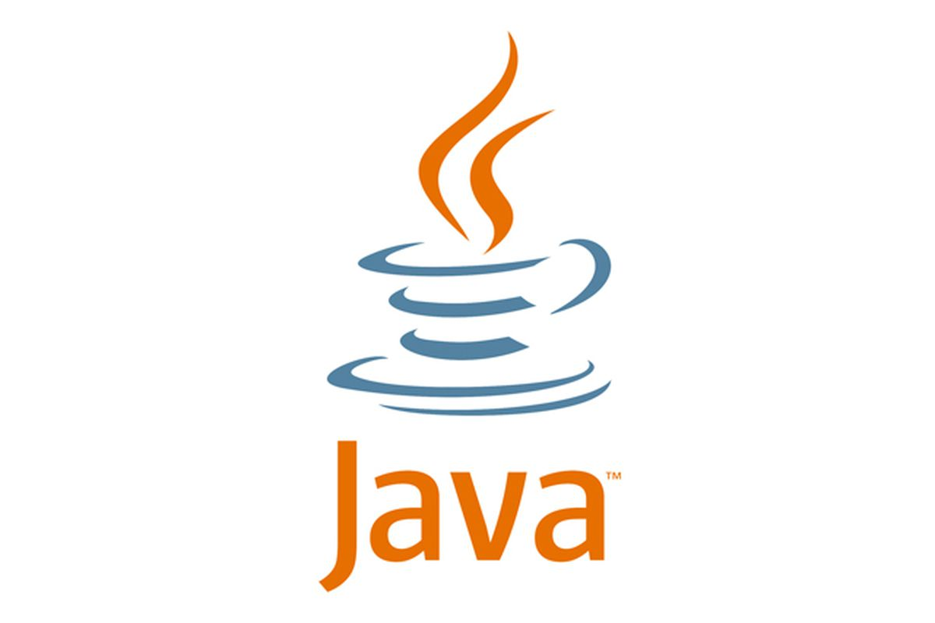
SOLID Principles
01
02
03

Slide 2
Content
01
SOLID Principles
02
Examples
03
Project

Slide 3
01
SOLID Principles

Slide 4
S.O.L.I.D.
S – Single responsibility principle – class should only have one responsibility
O – Open–closed principle – open for extension, but closed for modification
L – Liskov substitution principle – objects should be replaceable with instances of their subtypes without altering the correctness of that program
I – Interface segregation principle – many specific interfaces are better than one general interface
D – Dependency inversion principle – one should depend upon abstractions, not concretions

Slide 5
Single Responsibility Principle
A class should have only one responsibility
Reduces dependency complexity
Each additional responsibility is an axis to change the class
public class UserSettings {
public static void changeName(User user) {
// Grant option to change
}
}

Slide 6
Single Responsibility Principle
Still, classes can have multiple methods
Each method should have a single functionality part of the class responsibility
public class UserSettings {
public static void changeName(User user) {
// Grant option to change name
}
public static void selectRole(User user) {
// Grant option to select role
}
}

Slide 7
Open/Closed Principle
Software entities (classes, modules, functions, etc.) should be open for extension & closed for modification
Design the code in a way that new functionality can be added with minimum changes in the existing code
Extensibility:
Implementation takes future growth into consideration
New or modified functionality affects little or not at all the internal structure and data flow of the system

Slide 8
Open/Closed Principle
Software entities (classes, modules, functions, etc.) should be open for extension & closed for modification
Design the code in a way that new functionality can be added with minimum changes in the existing code
Reusability:
Software reusability refers to design features of a software element that enhance its suitability for reuse
Modularity
Low coupling
High cohesion
Coupling and Cohesion

Slide 9
Liskov Substitution
Derived types must be completely substitutable for their base types
Reference to the base class can be replaced with a derived class without affecting the functionality of the program module
Derived classes extend without replacing the functionality of old classes
OOP Inheritance
Student IS-A Person
Plus LSP
Student IS-SUBSTITUTED-FOR Person

Slide 10
OCP vs LSP
Liskov Substitution Principle is just an extension of the Open-Closed Principle
We must make sure that new derived classes are extending the base classes without changing their behavior

Slide 11
Interface Segregation Principle
Clients should not be forced to depend on methods they do not use
Segregate interfaces
Prefer small, cohesive interfaces
Divide "fat" interfaces into "role" interfaces

Slide 12
Fat Interfaces
Classes whose interfaces are not cohesive have "fat" interfaces
public interface Worker {
void work();
void sleep();
}
public class Robot implements Worker {
public void work() {}
public void sleep() {
throw new UnsupportedOperationException();
}
}

Slide 13
"Fat" Interfaces
Having "fat" interfaces:
Classes have methods they do not use
Increased coupling
Reduced flexibility
Reduced maintainability
Solutions to broken ISP
Small interfaces
Cohesive interfaces
Let the client define interfaces – "role" interfaces

Slide 14
Dependency Inversion Principle
High-level modules should not depend on low-level modules
Both should depend on abstractions
Abstractions should not depend on details
Details should depend on abstractions
Goal: decoupling between modules through abstractions

Slide 15
Dependency Inversion Principle
Button -> LampBulb Example – Robert Martin
Button depends on LampBulb
LampBulb
turnOn()
turnOff()
Button
poll()

Slide 16
Dependency Inversion Solution
Find the abstraction independent of details
SwitchableDevice
<interface>
turnOn()
turnOff()
Button
poll()
uses
implements
Lamp

Slide 17
DIP
Constructor injection - dependencies are passed through constructors
Pros
Classes self-documenting requirements
Works well without a container
Always valid state
Cons
Many parameters
Some methods may not need everything

Slide 18
Example
public class Copy {
private Reader reader;
private Writer writer;
public Copy(Reader reader, Writer writer) {
this.reader = reader;
this.writer = writer;
}
public void copyAll() {}
}

Slide 19
DIP
Setter Injection - dependencies are passed through setters
Pros
Can be changed anytime
Very flexible
Cons
Possible invalid state of the object
Less intuitive

Slide 20
Example
public class Copy {
private Reader reader;
private Writer writer;
public void setReader(Reader reader) {}
public void setWriter(Writer writer) {}
public void copyAll() {}
}

Slide 21
DIP
Parameter injection - dependencies are passed through method parameters
Pros
No change in rest of the class
Very flexible
Cons
Many parameters
Breaks the method signature
public class Copy {
public void copyAll(Reader reader, Writer writer) {}
}

Slide 22
UserInfo
You are given some classes
Refactor the code so that it conforms to DIP
Main
ConsoleFormatter
UserInfoProvider
UserDatabase

Slide 23
UserInfo
ConsoleClient
<Formatter>
<InfoProvider>
ConsoleFormatter
UserInfoProvider
<Database>
UserDatabase

